Slide 1
Chapter 5. Concurrency: Mutual Exclusion and Synchronization
CSci 474: Operating Systems Instructor: Dr. Jun Kong

Slide 2
Concurrency
Concurrency refers to concurrent activities.
Concurrent activities mean happening at the same time.
We saw in the earlier chapters that we want to run more than one process or thread at the same time.

Slide 3
Concurrency
Concurrency can happen in different situations:
  Multiple applications: running at once
  Structured applications: applications made of multiple pieces running at once
  OS Structure: OS made of multiple pieces running at once.
Concurrency presents a set of problems we must deal with.

Slide 4
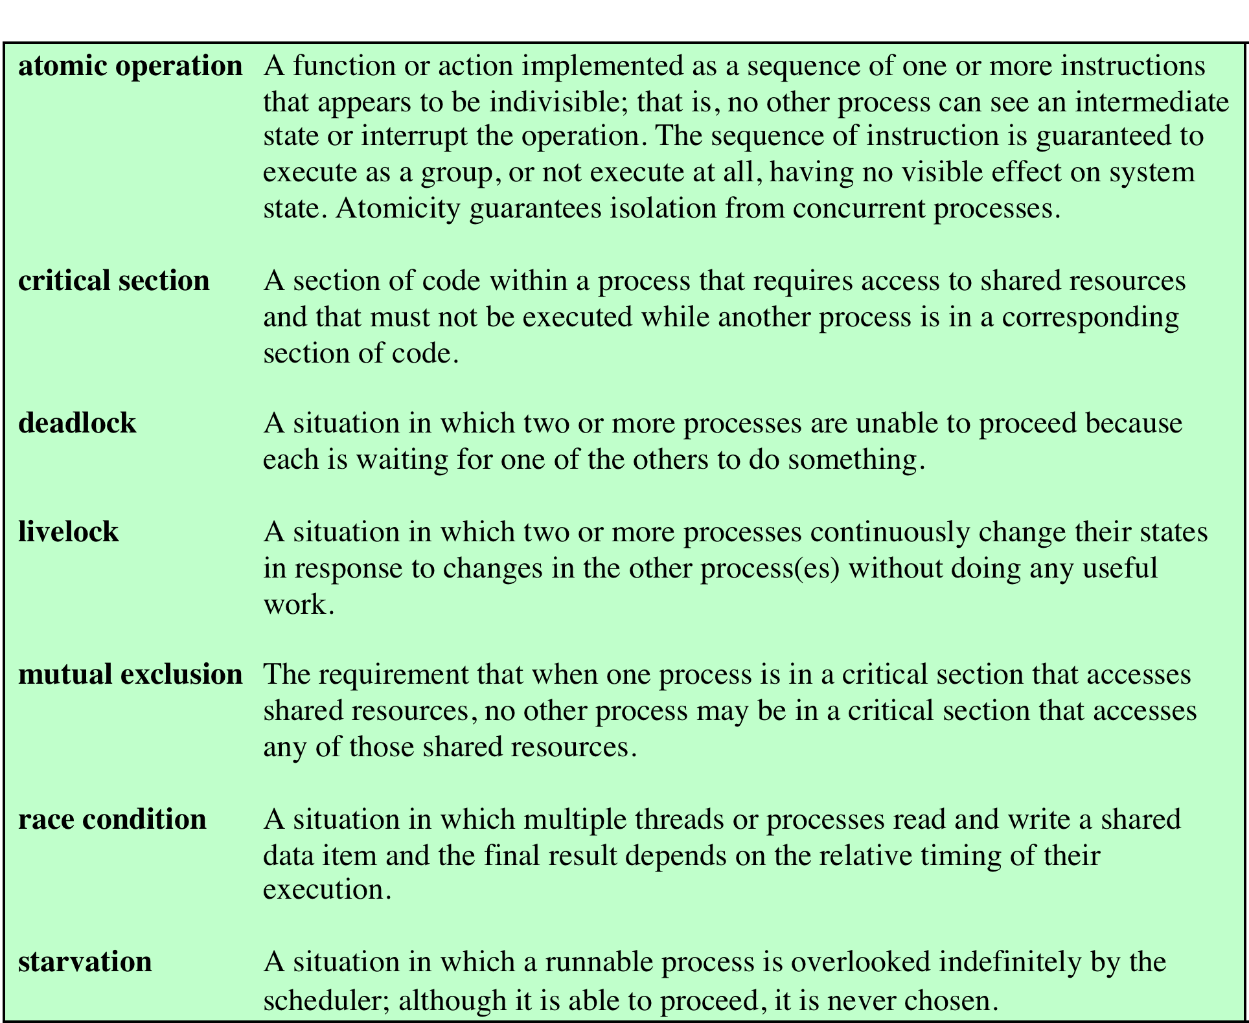

Slide 5
  void echo()
  {
  chin = getchar(); // assume chin is shared
  chout = chin; // by all processes
  putchar(chout);
  }

Slide 6
Menti: 12348470
  Thread 1 Thread 2
  . .
  chin = getchar(); .
  . chin = getchar();
  chout = chin; chout = chin;
  putchar(chout); .
  . putchar(chout);
  . .

Slide 7
Conclusion
There is a need to enforce mutual exclusion of access to shared variables.
This is true for uniprocessor systems due to interrupts, and in multiprocessor systems due to simultaneous execution.

Slide 8
Process Interaction
Processes unaware of each other
  Independent processes (competition)
Processes indirectly aware of each other
  Shared resource (cooperation)
Process directly aware of each other
  Communicate with each other (cooperation)

Slide 9
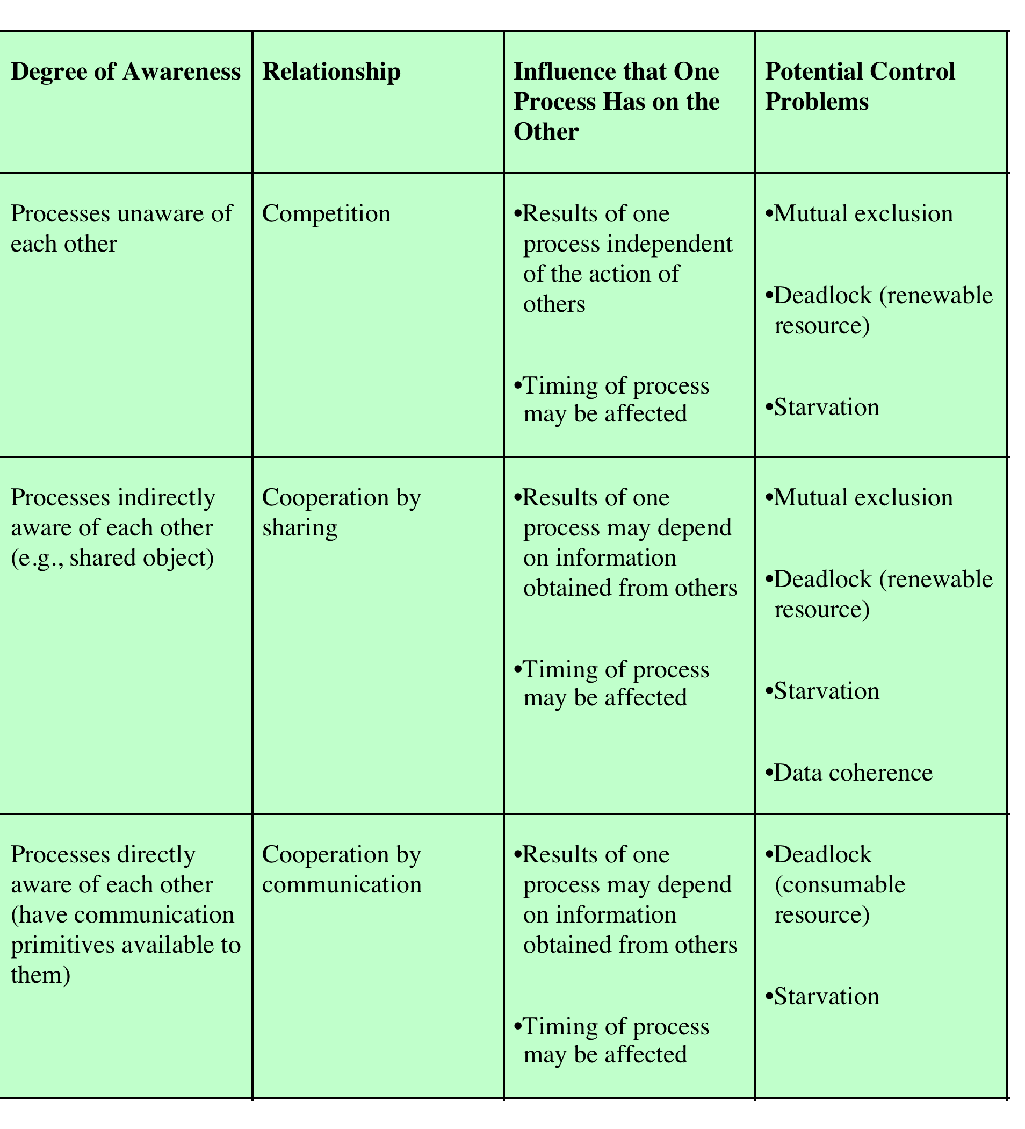

Slide 10
Competition among processes for resources
Mutual Exclusion
  Critical resource: only one process at a time can use it. Example is a printer.
  Critical sections: portion of program using a critical resource. Only one program at a time is allowed in its critical section.
Deadlock:
  two processes want two resources to run but each owns only one.
Starvation
  A process competing for a resource never receives it due to scheduling of other processes.

Slide 11
Cooperation among processes by sharing
The cooperation among processes by sharing has the same problems of mutual exclusion, deadlock, and starvation.
A new problem is data coherence, which means the problem of keeping data in a consistent state.

Slide 12
Data Coherence
P1:
a = a + 1
b = b + 1
P2:
a = a * 2
b = b * 2
If a=b=2, then a=6, b=6
But if interleaved:
a = a + 1
a = a * 2
b = b * 2
b = b + 1
Then a = 6 and b = 5
We wish to ensure a and b are always equal.
Menti: 83013401

Slide 13
Cooperation by Communication
Here there is no mutual exclusion issue since the processes are not sharing a resource but rather sending messages to each other, but there could still be deadlock or starvation.
A pair of processes may be deadlocked waiting for the other to send a message.
Three processes may be sending messages to each other, but one could be starved while the other two communicate.

Slide 14
Requirements for Mutual Exclusion
Only one process at a time is allowed in the critical section for a resource
A process that halts in its noncritical section must do so without interfering with other processes
No deadlock or starvation
A process must not be delayed access to a critical section when there is no other process using it
No assumptions are made about relative process speeds or number of processes
A process remains inside its critical section for a finite time only

Slide 15
Achieving Mutual Exclusion
Software: let the applications enforce it themselves through coding.
Hardware: disable interrupts or have special machine instructions to support mutual exclusion.
Operating System or Language: let the OS or programming language offer support for this capability.

Slide 16
Software solution – first attempt
Variable “turn” used to indicate which process may enter its critical section.
Other processes “busy wait” until it is their turn.

Slide 17
First Attempt
// process 0
while (turn != 0) // not my turn
// do nothing
//… code of critical section
turn = 1; // your turn
// process 1
while (turn != 1)
// do nothing
//… code of critical section
turn = 0;

Slide 18
Problem with the first attempt
Processes must alternate critical section usage, slowing down other processes to the slowest one.
A process that fails hangs the system.

Slide 19
Software solution – second attempt
Uses a variable for each process.
Solves problem of taking turns.

Slide 20
Second Attempt
// process 0
while (flag[1]) // p1 in crit.sec.
// do nothing
flag[0] = true; // I’m in
//… code of critical section
flag[0] = false; // I’m out
// process 1
while (flag[0])
// do nothing
flag[1] = true;
//… code of critical section
flag[1] = false;
Menti: 55338650

Slide 21
Problem with the second attempt
Doesn’t enforce mutual exclusion since each could see the other’s flag set to false and proceed.
Process failing inside its critical section hangs system.

Slide 22
Software solution: third attempt
Same as second attempt but set flag before while loop.

Slide 23
Third Attempt
// process 0
flag[0] = true; // I want in
while (flag[1]) // p1 in crit.sec.
// do nothing
//… code of critical section
flag[0] = false; // I’m out
// process 1
flag[1] = true;
while (flag[0])
// do nothing
//… code of critical section
flag[1] = false;
Menti: 31719159

Slide 24
The problem with the third attempt
Process failing inside its critical section hangs system.
Deadlocks if both set flag to true before while loop.

Slide 25
Software solution – fourth attempt
Same as the third attempt but after setting flag, check other process flag and reset own flag before entering critical section if other’s is set.

Slide 26
Fourth Attempt
// process 0
flag[0] = true; // I want in
while (flag[1]) // p1 is in
{
flag[0] = false; // defer to p1
// delay
flag[0] = true; // try again
}
//… code of critical section
flag[0] = false; // I’m out
// process 1
flag[1] = true;
while (flag[0])
{
flag[1] = false;
// delay
flag[1] = true;
}
//… code of critical section
flag[1] = false;
Menti: 17096845

Slide 27
The problem with the fourth attempt
Process failing inside its critical section hangs system.
Situation is possible for indefinite delay (livelock). This happens if both processes repeatedly defer to each other (mutual courtesy).

Slide 28
Dekker’s Algorithm
Uses a turn flag to decide in matters of deference so that the problems in the fourth attempt are solved.
// process 0
flag[0] = true;
while (flag[1])
{
if (turn == 1)
{
flag[0] = false;
while (turn ==1)
// busy wait
flag[0] = true;
}
}
//… code of critical section
turn = 1;
flag[0] = false;
// process 1
flag[1] = true;
while (flag[0])
{
if (turn == 0)
{
flag[1] = false;
while (turn ==0)
// busy wait
flag[1] = true;
}
}
//… code of critical section
turn = 0;
flag[1] = false;

Slide 29
Peterson’s Algorithm
Similar but more elegant solution than Dekker’s.
I want to enter
P0:
P1:
Defer to p0
flag[0] = true;
turn = 1;
while (flag[1] && turn == 1)
/* do nothing */
/* critical section */
flag[0] = false;
/* remainder */
flag[1] = true;
turn = 0;
while (flag[0] && turn == 0)
/* do nothing */
/* critical section */
flag[1] = false;
/* remainder */
While p0 wants
to enter and p0’s turn, I’ll wait.
I’m done

Slide 30
Mutual Exclusion Hardware Support
Two ways hardware can support mutual exclusion:
  1) Interrupt disabling
  2) Special machine instructions

Slide 31
Mutual Exclusion Hardware Support
Interrupt Disabling
In a uniprocessor system, disabling interrupts lets a process complete its critical section without worrying about being interrupted.
Problems:
  Degrades multitasking performance.
  Doesn’t work on a multiprocessor system where multiple processes execute at once regardless of interrupts.

Slide 32
Special Machine Instructions
It is a problem if a process wishes to do two operations, but after completing the first operation, finds its data changed by some other process before it can complete the second one.
A hardware solution to this is to have special machine instructions that execute two operations atomically within a single machine.
For example, reading and writing or testing and setting a single memory location.
Since they are performed within a single machine cycle, they can’t be interrupted or interfered with by another process.

Slide 33
Test and Set
// code that uses a machine
// instruction called “testset” to
// create a critical section
Shared variable x=0
while (true)
{
while (!testset(x))
// do nothing
// critical section code here
x = 0;
// remaining code…
}
// this procedure is implemented
// as a single machine instruction:
boolean testset (int &i)
{
if (i == 0) {
i = 1;
return true;
} else {
return false;
}
}

Slide 34
Exchange Instruction
// code that uses a machine
// instruction called “exchange” to
// create a critical section
Shared variable x=0
Local variable keyi
keyi = 1;
while (keyi != 0)
exchange(keyi, x);
// critical section code here
exchange(keyi, x);
// remainding code…
If x is 1, then it will busy-wait
until x is 0
// this procedure is implemented
// as a single machine instruction:
void exchange(int &reg, int &mem)
{
int temp;
temp = mem;
mem = reg;
reg = temp;
}

Slide 35
Special Machine Instructions
Advantages
  Applicable to any number of processes on either a single processor or multiple processors sharing main memory
  It is simple and therefore easy to verify
  It can be used to support multiple critical sections

Slide 36
Special Machine Instructions
Drawbacks to special machine instructions are:
Busy-waiting is employed:
Starvation possible since the process that runs next is arbitrary.
Deadlock is possible if p1 enters the critical section and is interrupted by a higher priority process p2. p2 cannot enter due to p1, and p1 will not be scheduled due to p2.

Slide 37
Semaphores
Semaphores are an OS or language mechanism to support concurrency.
A semaphore is used for signaling
  If a process is waiting for a signal, it is suspended until that signal is sent
  Queue is used to hold processes waiting on the semaphore.
A semaphore is a variable with an integer value
  May be initialized to a nonnegative number
  wait(s) operation decrements the value
  signal(s) operation increments value
Semaphore operations are atomic.

Slide 38
Semaphore values
Values of a semaphore s:
s > 0: s processes may call wait(s) without delay
s = 0: no processes waiting
s < 0: s processes are suspended waiting on s.

Slide 39
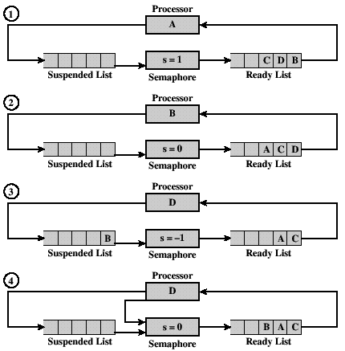
D is producer, A,B,C are consumers

Slide 40
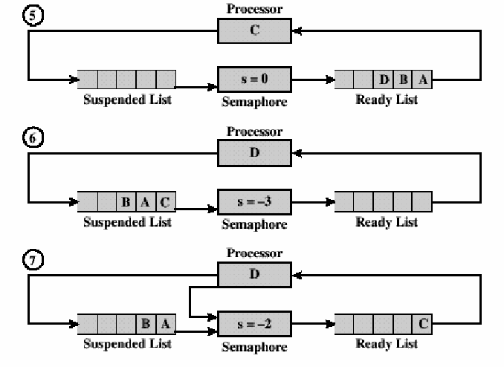

Slide 41
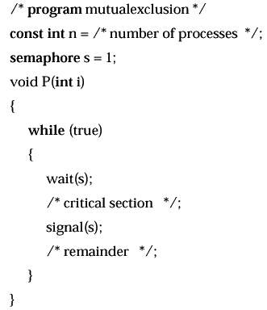

Slide 42
Event Ordering
Semaphore S=0;
void p1()
{
…
event 1
signal(s);
…
}
void p2()
{
…
wait(s);
event 2
…
}

Slide 43
Producer / Consumer Problem
One or more producers are generating data and placing these in a buffer
A single consumer is taking items out of the buffer one at time
Only one producer or consumer may access the buffer at any one time
The size of the buffer is infinite
A consumer is blocked when the buffer is empty
Menti: 87455200

Slide 44
Counting Semaphores
/* program producerconsumer */
semaphore n=0;
semaphore s=1;
void producer()
{
while (true)
{
produce();
wait(s);
append();
signal(s);
signal(n);
}
}
void consumer()
{
while (true)
{
wait(n);
wait(s);
take();
signal(s);
consume();
}
}

Slide 45
Finite Buffer Solution
A finite buffer solution can be constructed by adding a semaphore to keep track of the buffer size.
A semaphore “e” is used to keep from inserting into a full buffer.

Slide 46
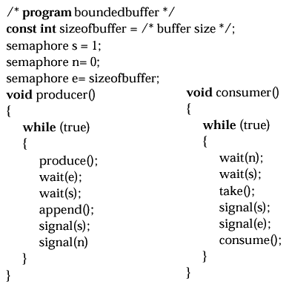
wait(e) can
only be called
sizeofbuffer
times before
having to wait
(means buffer
is full).
signal(e) each
time an item
is taken from
the buffer.

